Slide 1

Python Power: Leveraging ArcGIS Notebooks for Efficient Data ETL
Jin Yao, 4/18/2024
2024 MidAmerica GIS Symposium

Slide 2
Do you use open-source software?
Python, R, …?
IDE?
Versions of libraries or packages?
Notes:
Ask audience a question: do you use open-source software? If yes, which one (R, Python, or others). Which IDE (Integrated development Environment) do you use?
I use R Studio for R, Anaconda for Python (Spyder, and Jupyter Notebook)
How do you keep up with the versions of libraries or packages? Do you collaborate with colleagues, how do you have the same version of libraries?

Slide 3
Python Power: Leveraging ArcGIS Notebooks for Efficient Data ETL
Jin Yao, 4/18/2024
2024 MidAmerica GIS Symposium

Slide 4
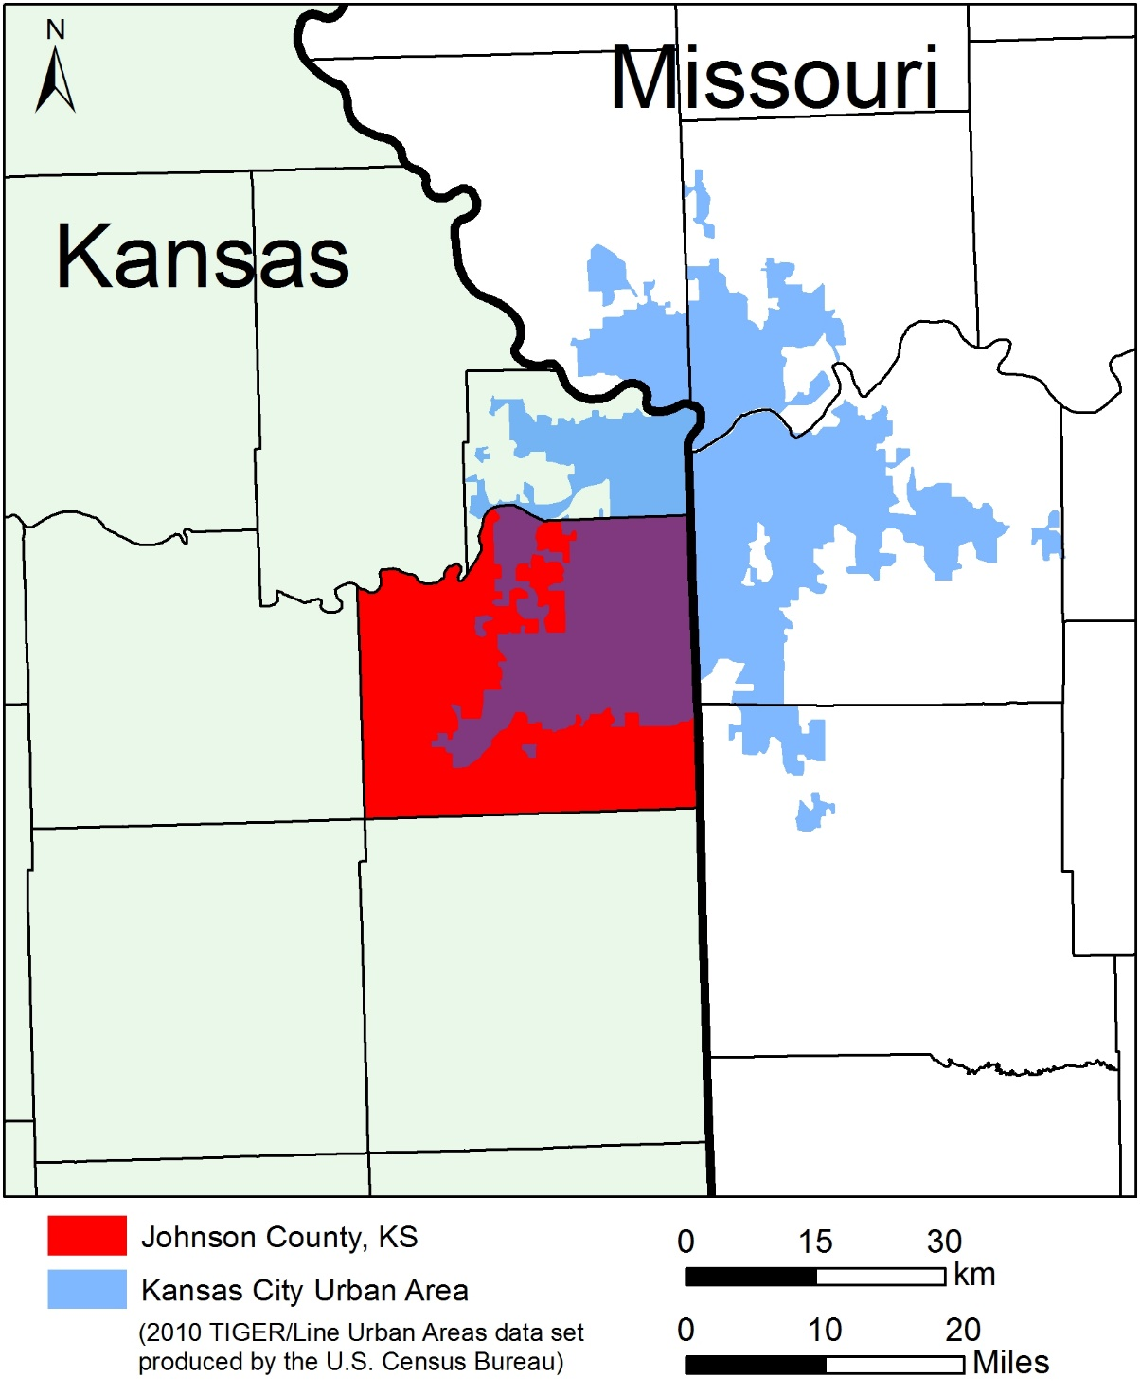
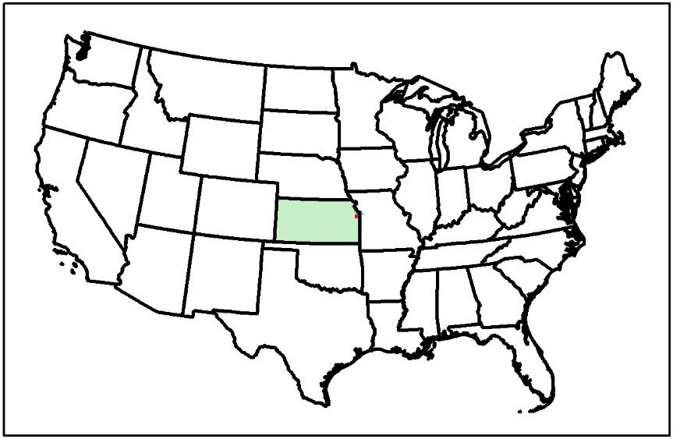
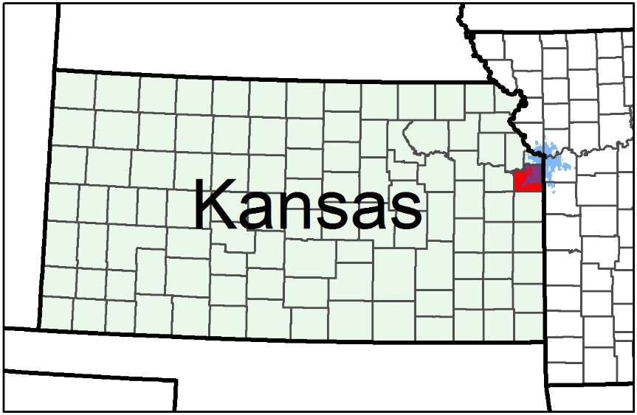
Johnson County, KS

Slide 5








About My Team and Me
AIMS
Johnson County Government, KS
Me: Senior Data Analyst
SQL
Python, R
ArcGIS
Tableau
Notes:
JoCo AIMS, Automated Information Mapping System, county GIS team, inside our centralized IT department. 18 employees, supporting ~ 30 departments.
Me: Senior Data Analyst, I apply data visualization, statistical analysis, and machine learning to support decision-making of county departments, especially those in the fields of human services, health, and criminal justice. support the Human Services departments: Developmental Supports, Emergency Medical Services, Aging and Human Services, Mental Health Center, Public Health and Environment, Corrections, a little of justice system.

Slide 6
Outline
ArcGIS Pro’s Python Environment
Download Data Using Census API
Export Data to Microsoft SQL Server

Slide 7
ArcGIS Pro’s Python Environment

Slide 8
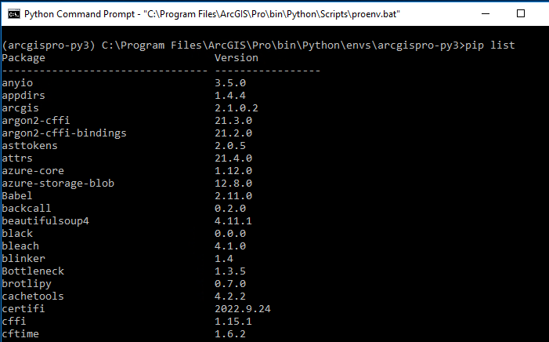

Slide 9

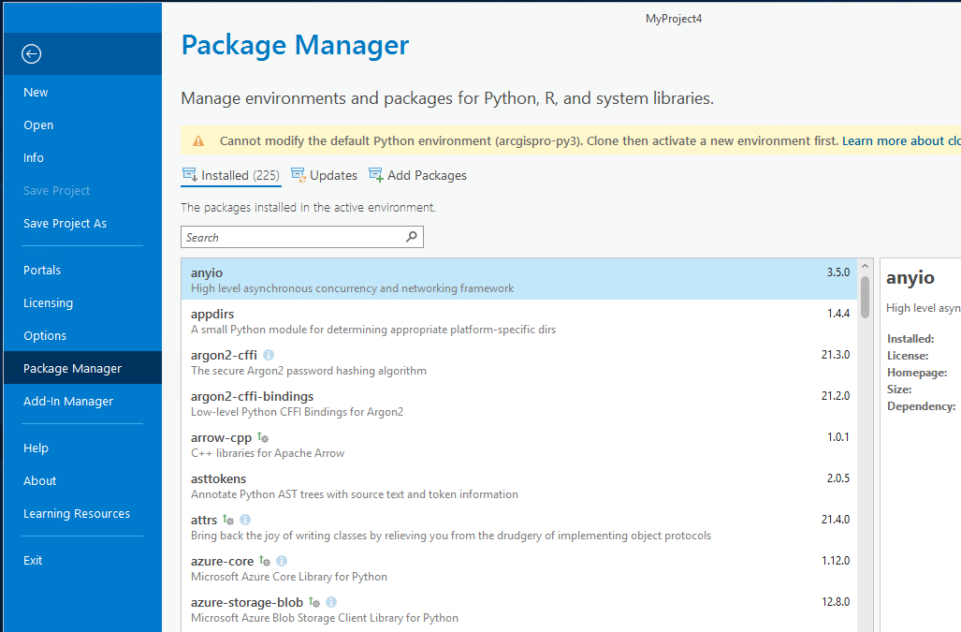

Slide 10
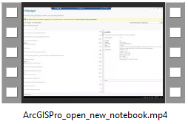

Start a New Notebook
Start in ArcGIS Pro
Start at Python Command Prompt

Slide 11
2. Download Data Using Census API

Slide 12
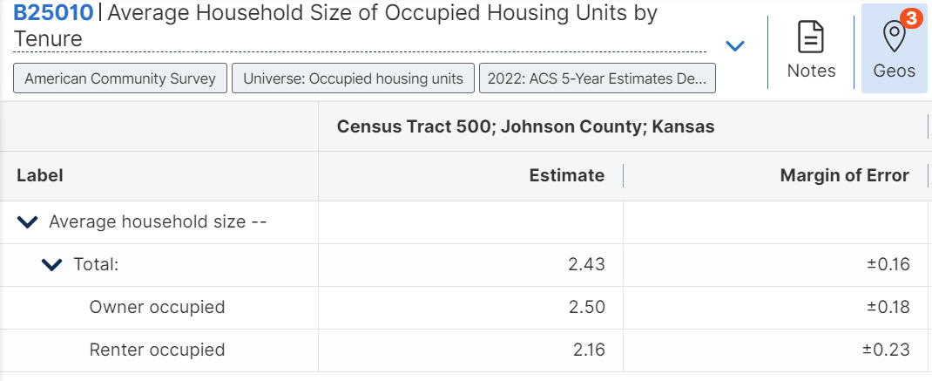
Example: download Average Household Size
from 2022 ACS 5 year data
at all census tracts in JoCo
Notes:
Url: https://data.census.gov/table?q=B25010:%20Average%20Household%20Size%20of%20Occupied%20Housing%20Units%20by%20Tenure&g=1400000US20091050000,20091050100,20091050200

Slide 13
Census Data API, 5 components
https://api.census.gov
/data/2022/acs/acs5
?get=GEO_ID,B25010_001E,B25010_002E,B25010_003E
&for=tract:*
&in=state:20;county:091
Host
Dataset
Variables
Geo unit
Geo extent
Notes:
https://api.census.gov/data/2022/acs/acs5?get=GEO_ID,B25010_001E,B25010_002E,B25010_003E&for=tract:*&in=state:20;county:091
Census API,
API: Application programming interface
First 2 components: base URL; anything after “?” are query parameters
Briefly explain B25010_001E, _002E, 003E
Finding a sample URL, edit it to get the data that you want
Census DATA API: raw statistical data from programs and surveys across the Bureau
1,251 detailed datasets, fit into 17 high level surveys and programs as of 8/29/2022
Demo using the example API to get data, resulting data in json format

Slide 14
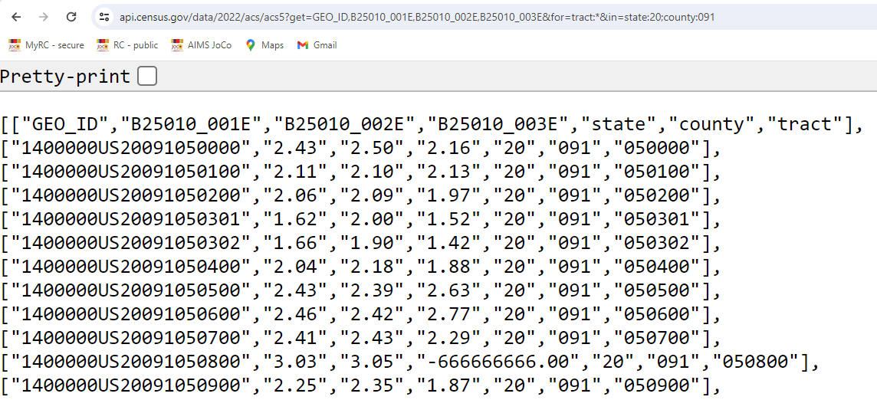
Census Data API, result of API call
Notes:
https://api.census.gov/data/2022/acs/acs5?get=GEO_ID,B25010_001E,B25010_002E,B25010_003E&for=tract:*&in=state:20;county:091
The result of an API call is a json file. In Python we will send the request, get the json, and convert Json to a python dataframe.

Slide 15
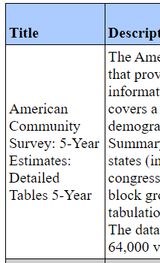
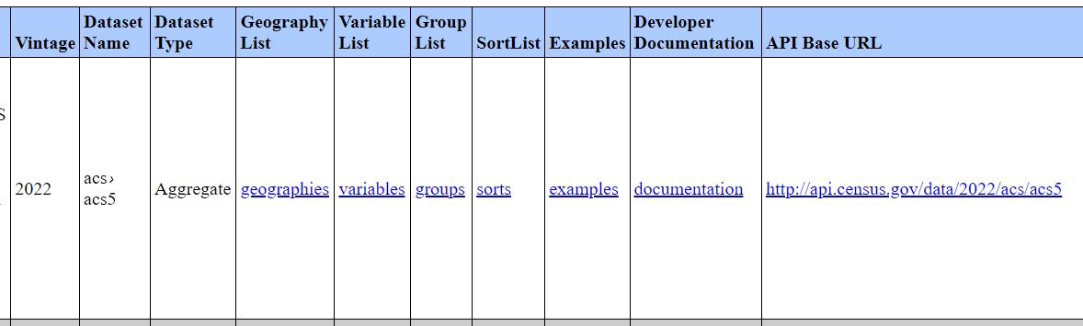
To find Census API: Datasets in /data/2022/acs/acs5 and its descendants
https://api.census.gov/data/2022/acs/acs5.html

Slide 16
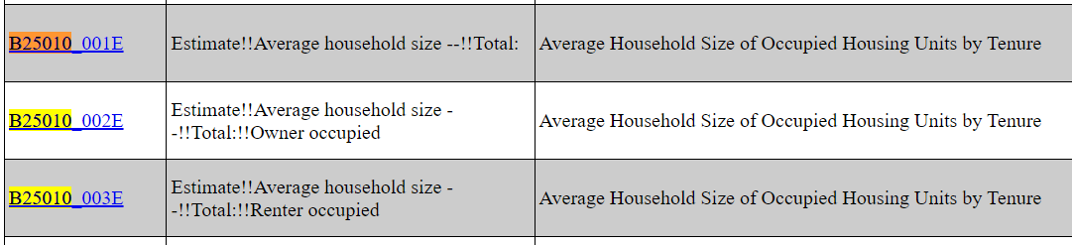
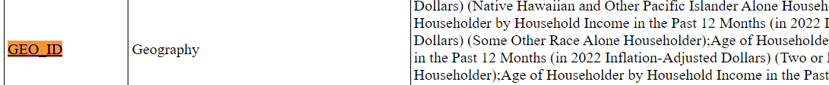
Census Data API: Variables in /data/2022/acs/acs5/variables

Slide 17
Python code to request data
See Demo Notebook

Slide 18
3. Export Data to Microsoft SQL Server
See Demo Notebook

Slide 19
Outline
ArcGIS Pro’s Python Environment
Download Data Using Census API
Export Data to Microsoft SQL Server

Slide 20
References
Census Bureau tutorial video on downloading data using API
Census Bureau Video Tutorials – How to use Census API
Data at your door: Census API Decoded
Python Tutorial: Using the Census API
Census Bureau Available APIs
This slide deck and the demo ArcGIS notebook can be downloaded https://github.com/JinMcBurney/MAGIC_2024_Symposium

Slide 21
Contact Us
AIMS website: https://aims.jocogov.org/
About AIMS: https://arcg.is/1mKivb0
Jin Yao: jin.yao@jocogov.org

